Slide 1


DEPARTMENT BES-1
  Course: Data Structures
Course code: 24sc1203
    Topic: Time complexity
Session-02

Slide 2



AIM OF THE SESSION
To familiarize students in evaluating time complexities.
INSTRUCTIONAL OBJECTIVES
This Session is designed to:
Understand the concept of Various Algorithms
Learn the Mathematical background for deriving time complexity.
Analyse the algorithm to compute time complexity.
LEARNING OUTCOMES
At the end of this session, you should be able to:
Evaluate the time complexities of the different Algorithmic solutions for various types of Problems.
Write the notations for calculating the running time complexity of different algorithms

Slide 3
SESSION INTRODUCTION
Time Complexity with Asymptotic Notations.
Examples of Time Complexity.

Slide 4
TIME COMPLEXITY - EXAMPLES
Examples :
Odd or even number
Accessing an element of an array
CODE SNIPPET
If (n %2 ==0)
{
printf(“Even”);}
else{
printf(“Odd”)
}
CODE | UNIT
If (n %2 ==0) | 1
{
printf(“Even”);} | 1
else{
printf(“Odd”); | 1
}
TOTAL COST | 3
High coefficient should be considered , others ignored
Time complexity : O(1) , as it takes constant time

Slide 5
TIME COMPLEXITY - EXAMPLES
Examples :
Traversing an Array, Linked List.
Linear search
CODE SNIPPET
for(i=0;i<n;i++)
{
s=s+I;
}
CODE | UNIT
for (i=0;i<n;i++) | n+1
{
S=s+i; | n
}
TOTAL COST | 2n+1
High coefficient should be considered , others ignored
Time complexity : O(n)

Slide 6
TIME COMPLEXITY - EXAMPLES
Examples :
Traversing an 2D Array.(Matrix Multiplication)
Bubble Sort.
Insertion sort.
CODE SNIPPET
for(i=0;i<n;i++)
{
for(j=0;j<n;j++)
{
c[i][j]=a[i][j]+b[i][j];
}
}
CODE | UNIT
for (i=0;i<n;i++) | n+1
{
for (i=0;i<n;i++) | n(n+1)
{
c[i][j]=a[i][j]+b[i][j]; | n*n
}
}
TOTAL COST | 2n²+2n+1
High coefficient should be considered , others ignored
Time complexity : O(n²)

Slide 7
TIME COMPLEXITY - EXAMPLES
Examples :
Binary search
CODE SNIPPET
for (i = 1; i <= n; i=i*2)
{printf("Hello World \n");}
CODE | UNIT
for (i = 1; i <= n; i=i*2) | n/2+1
{printf("Hello World \n"); | n/2
} | log2(n)
for (i = n; i >= 0; i=i/2) | n/2+1
{
printf("Hello World \n"); | n/2
}
TOTAL COST | log2(n)
CODE SNIPPET
for (i = n; i >= 0; i=i/2)
{
printf("Hello World \n");
}
Time complexity : O(log2(n)))

Slide 8
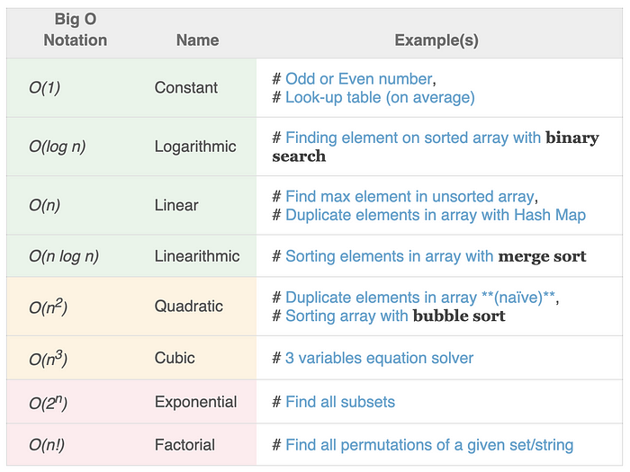
COMMON TIME COMPLEXITIES

Slide 9
SUMMARY
Time complexities of various well known Algorithms
Mathematical computations of well known Algorithms
Examples of Time Complexities.

Slide 10
SELF-ASSESSMENT QUESTIONS
1. O( n² ) is the worst case time complexity, so among the given options it can represent :-
O( n )
O( 1 )
O ( nlogn )
All of the above
2. Which of the following sorting algorithms has the lowest worst-case complexity?
Merge Sort
Bubble Sort
Quick Sort
Selection Sortd

Slide 11
TERMINAL QUESTIONS
What is the worst ,best and average case time complexities of binary search?
Ans: Best O(n), Average and Worst O(n²)
2. What is the importance of time complexity?
Ans:The time complexity of an algorithm determines how long it will take to execute it. The higher the time complexity, the longer it will take for that algorithm to finish running.
3. Describe the various types of time complexities of Merge sort, quick sort and bubble sort?

Slide 12
REFERENCES FOR FURTHER LEARNING OF THE SESSION
Reference Books:
A.V.Aho, J. E. Hopcroft, and J. D. Ullman, “Data Structures And Algorithms”, Pearson Education, First Edition Reprint2003.
Horowitz, Sahni, Anderson Freed, “Fundamentals of datastructures in C” , Second Edition-2007.
R. F. Gilberg, B. A. Forouzan, “Data Structures”, Second Edition, Thomson India Ed ition, 2005
Robert Kruse, C.L. Tondo, Bruce Leung, Shashi Mogalla, “Data Structures & Program Design in C”, FourthEdition-2007.
Sites and Web links:
  https://nptel.ac.in/courses/106102064
  https://nptel.ac.in/courses/106101060/4
  https://www.edx.org/course/algorithms-and-data-structures-1
  https://in.udacity.com/course/intro-to-algorithms--cs215
  https://www.coursera.org/learn/data-structures?action=enroll
  https://www.geeksforgeeks.org/types-of-asymptotic-notations-in-complexity-analysis-of-algorithms/

Slide 13
THANK YOU
Team – Data Structures

